Slide 1
CM-DM noise filtering
Furkan Tokgöz

Slide 2
Switching Mode Power Supply
Decrease in losses
Smaller equipments
High power density

Slide 3
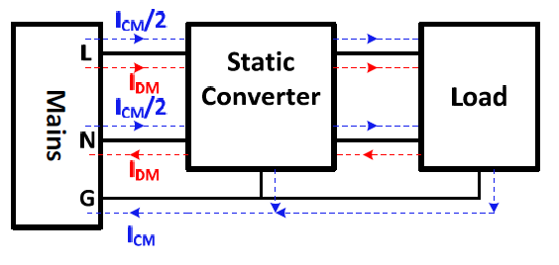
Noises
Fig.1. CM and DM noises on a system [1]

Slide 4
Noises
Common mode noises:
Parasitic capacitances
dV/dt
Differential mode noises:
Parasitic inductances
di/dt [2]

Slide 5
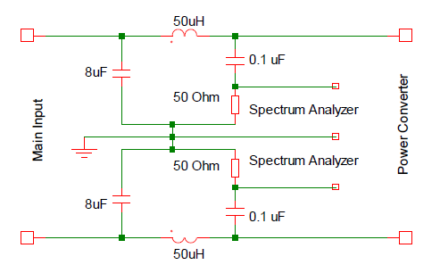
Measurement of Noises
Line Impedance Stabilization Network (LISN)
Fig.2. Circuit schematic of LISN [3]

Slide 6
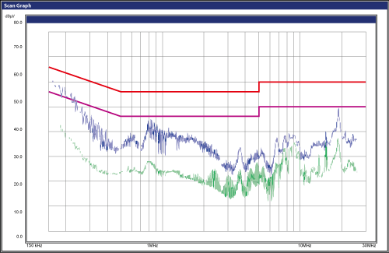
Filtering
150 kHz-30 MHz
Fig.2. Noise amplitude vs frequency graph

Slide 7
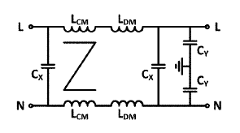
Filtering
Fig.4. Typical EMI filter [1]

Slide 8
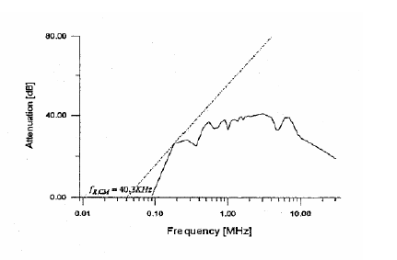
Filtering
Fig.3. Attenuation vs frequency graph [4]

Slide 9


Filtering
Corner frequency
s
Leakage Inductance
s

Slide 10
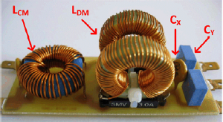
Filtering
Fig.5. Photo of designed filter [1]

Slide 11
References
Modeling and Design of Passive Planar Components for EMI Filters, Wenhua Tan
Electrical, Thermal, and EMI Designs of High-Density, Low-Profile Power Supplies, Zhang, Michael Tao
Design and implementation of EMI filter for high frequency (MHz) power converters, A.Majid, J.Saleem
Conducted EMI filter design for SMPS, Jukka-Pekka Sjöroos

